Slide 1
Style Translation Test
This powerpoint contains the best images generated by Stable Diffusion with their main style labels next to them. All text prompting data and other model information such as sampling method and CGF scaling are included in the speaker notes of each slide.

Slide 2
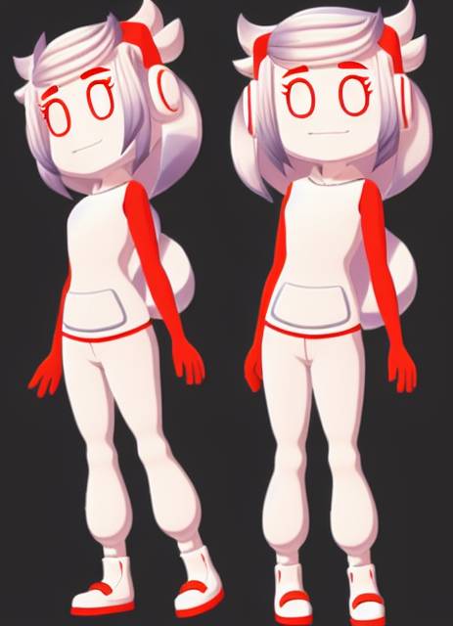
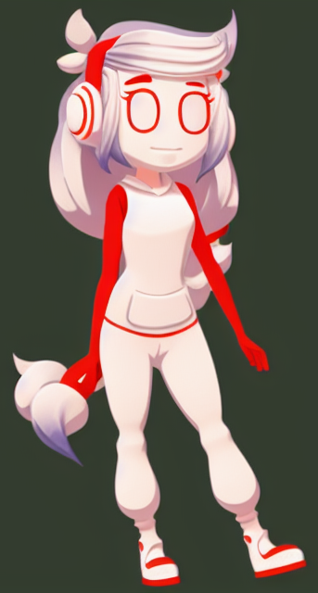
Style:
Cartoon/
Flat Color
Notes:
<lora:A1013D_01-000002:0.7> a cartoon character girl, thick outline, flat colors, cel shading, flat shading, disney channel, cartoon network, toon, lineart, line art, outline, full body, camera zoom out
Negative prompt: smooth shading, 3D, 3D render, logo, Watermark, bad artist, blur, blurry, text, b&w, 3d, bad art, poorly drawn, disfigured, deformed
Steps: 50, Sampler: Euler a, CFG scale: 7, Seed: 3943592725, Size: 640x640, Model hash: 1254103966, Model: protogenV22Anime_22
Time taken: 54.75sTorch active/reserved: 5709/6544 MiB, Sys VRAM: 8192/8192 MiB (100.0%)

Slide 3
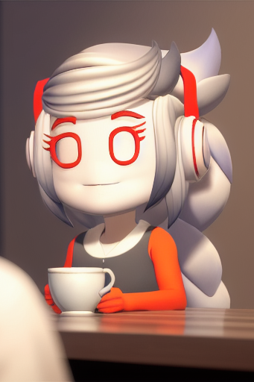
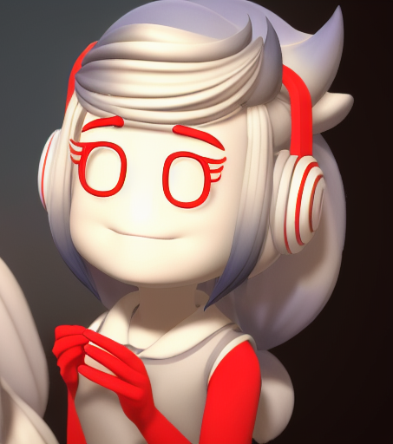
Style:
Pixar
Notes:
<lora:A1013D_01-000002:0.7> a cartoon character in a hyper realistic rendition, high detail, intricate detail, sharp, RAW candid cinema, woman, studio, 16mm, ((color graded portra 400 film)) ((remarkable color)), (ultra realistic), textured skin, remarkable detailed pupils, ((realistic dull skin noise)), ((visible skin detail)), ((skin fuzz)), (dry skin) shot with cinematic camera, Photorealistic, Hyperrealistic, Hyperdetailed, analog style, hip cocked, demure, low cut, black lace, detailed skin, pores, smirk, smiling eyes, matte skin, outdoor cafe, soft lighting, subsurface scattering, realistic, heavy shadow, masterpiece, best quality, ultra realistic, 8k, golden ratio, Intricate, High Detail, film photography, soft focus, Digital art, glow effects, Hand drawn, render, 8k, octane render, cinema 4d, blender, dark, atmospheric 4k ultra detailed, cinematic sensual, Sharp focus, humorous illustration, big depth of field, Masterpiece, colors, 3d octane render, 4k, concept art, trending on artstation, hyperrealistic, Vivid colors, modelshoot style, (extremely detailed CG unity 8k wallpaper), professional majestic oil painting by Ed Blinkey, Atey Ghailan, Studio Ghibli, by Jeremy Mann, Greg Manchess, Antonio Moro, trending on ArtStation, trending on CGSociety, Intricate, High Detail, Sharp focus, dramatic, photorealistic painting art by midjourney and greg rutkowski
Negative prompt: (nose:2.0), B&W, logo, Watermark, bad artist, blur, blurry, text, b&w, 3d, bad art, poorly drawn, disfigured, deformed, extra limbs, ugly hands, extra fingers, canvas frame, cartoon, 3d, disfigured, bad art, deformed, extra limbs, weird colors, duplicate, morbid, mutilated, out of frame, extra fingers, mutated hands, poorly drawn hands, poorly drawn face, mutation, deformed, ugly, bad anatomy, bad proportions, extra limbs, cloned face, disfigured, out of frame, ugly, extra limbs, bad anatomy, gross proportions, malformed limbs, missing arms, missing legs, extra arms, extra legs, mutated hands, fused fingers, too many fingers, long neck, Photoshop, video game, ugly, tiling, poorly drawn hands, poorly drawn feet, poorly drawn face, out of frame, mutation, mutated, extra limbs, extra legs, extra arms, disfigured, deformed, cross-eye, body out of frame, bad art, bad anatomy, 3d render, B&W, logo, Glasses, Watermark, bad artist, blur, blurry, text, b&w, 3d, bad art, poorly drawn, disfigured, deformed, extra limbs, ugly hands, extra fingers, canvas frame, cartoon, 3d, disfigured, bad art, deformed, extra limbs, weird colors, blurry, duplicate, morbid, mutilated, out of frame, extra fingers, mutated hands, poorly drawn hands, poorly drawn face, mutation, deformed, ugly, blurry, bad anatomy, bad proportions, extra limbs, cloned face, disfigured, out of frame, ugly, extra limbs, bad anatomy, gross proportions, malformed limbs, missing arms, missing legs, extra arms, extra legs, mutated hands, fused fingers, too many fingers, long neck, Photoshop, video game, ugly, tiling, poorly drawn hands, poorly drawn feet, poorly drawn face, out of frame, mutation, mutated, extra limbs, extra legs, extra arms, disfigured, deformed, cross-eye, body out of frame, blurry, bad art, bad anatomy, 3d render, logo, Glasses, Watermark, bad artist, blur, blurry, text, b&w, 3d, bad art, poorly drawn, disfigured, deformed, extra limbs, ugly hands, extra fingers, canvas frame, cartoon, 3d, disfigured, bad art, deformed, extra limbs, weird colors, duplicate, morbid, mutilated, out of frame, extra fingers, mutated hands, poorly drawn hands, poorly drawn face, mutation, deformed, ugly, bad anatomy, bad proportions, extra limbs, cloned face, disfigured, out of frame, ugly, extra limbs, bad anatomy, gross proportions, malformed limbs, missing arms, missing legs, extra arms, extra legs, mutated hands, fused fingers, too many fingers, long neck, Photoshop, video game, ugly, tiling, poorly drawn hands, poorly drawn feet, poorly drawn face, out of frame, mutation, mutated, extra limbs, extra legs, extra arms, disfigured, deformed, cross-eye, body out of frame, bad art, bad anatomy, 3d render
Steps: 50, Sampler: Euler a, CFG scale: 7, Seed: 1662469907, Size: 512x512, Model hash: 1254103966, Model: protogenV22Anime_22
Time taken: 27.46sTorch active/reserved: 5404/6110 MiB, Sys VRAM: 8192/8192 MiB (100.0%)

Slide 4
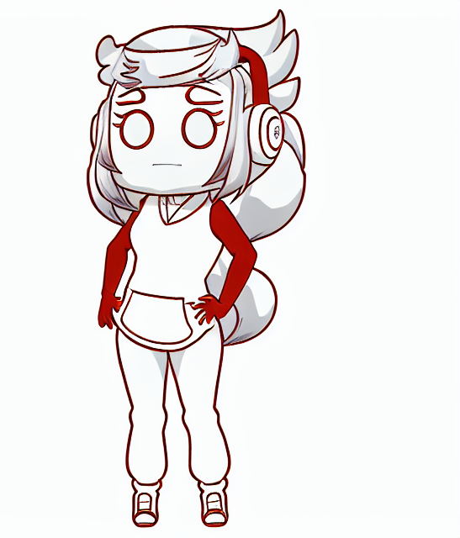
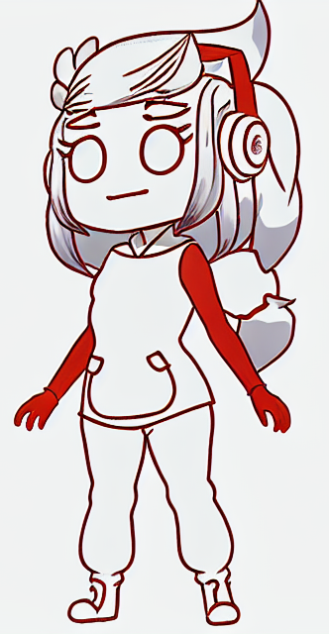
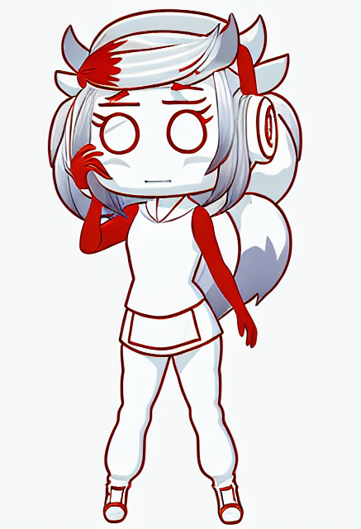
Style: Chibi
Notes:
<lora:A1013D_01-000002:0.7> a cartoon character anime girl, (chibi:1.5), (thick outline:1.4), flat colors, (cel shading:1.5), flat shading, anime, manga, one punchman, lineart, line art, outline, full body, camera zoom out, limited color palette, red color, white color, <lora:animeLineartMangaLike_v30MangaLike:1>
Negative prompt: smooth shading, 3D, 3D render, logo, Watermark, bad artist, blur, blurry, text, b&w, 3d, bad art, poorly drawn, disfigured, deformed, gradient color, gradient colors,
Steps: 50, Sampler: Euler a, CFG scale: 7, Seed: 3326766470, Size: 640x640, Model hash: 1254103966, Model: protogenV22Anime_22
Time taken: 53.53sTorch active/reserved: 5709/6544 MiB, Sys VRAM: 8192/8192 MiB (100.0%)

Slide 5
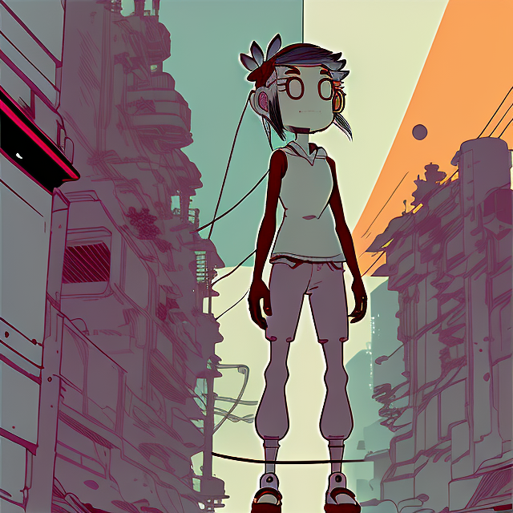
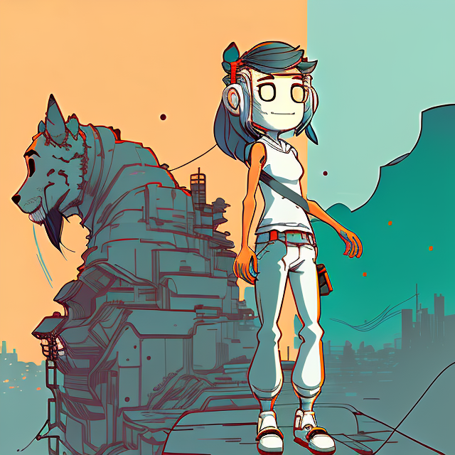
Style: Ink Punk
Notes:
<lora:A1013D_01-000002:0.7> a cartoon character in (nvinkpunk:1.1) style, full body, camera zoom out, Studio ghibli style
Negative prompt: (nose:2.0), logo, Glasses, Watermark, bad artist, blur, blurry, text, b&w, 3d, bad art, poorly drawn, disfigured, deformed, extra limbs, ugly hands, extra fingers, canvas frame, cartoon, 3d, disfigured, bad art, deformed, extra limbs, weird colors, blurry, duplicate, morbid, mutilated, out of frame, extra fingers, mutated hands, poorly drawn hands, poorly drawn face, mutation, deformed, ugly, blurry, bad anatomy, bad proportions, extra limbs, cloned face, disfigured, out of frame, ugly, extra limbs, bad anatomy, gross proportions, malformed limbs, missing arms, missing legs, extra arms, extra legs, mutated hands, fused fingers, too many fingers, long neck, Photoshop, video game, ugly, tiling, poorly drawn hands, poorly drawn feet, poorly drawn face, out of frame, mutation, mutated, extra limbs, extra legs, extra arms, disfigured, deformed, cross-eye, body out of frame, blurry, bad art, bad anatomy, 3d render
Steps: 50, Sampler: Euler a, CFG scale: 7, Seed: 1767980748, Size: 640x640, Model hash: 2182245415, Model: inkpunk_inkpunkDiffusion_v2
Time taken: 43.24sTorch active/reserved: 5709/6892 MiB, Sys VRAM: 8192/8192 MiB (100.0%)

Slide 6
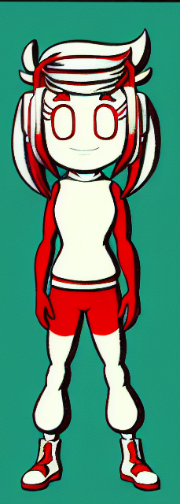
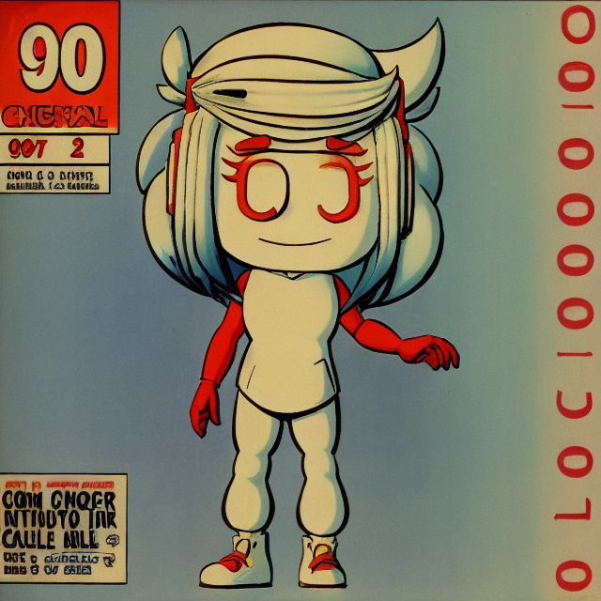
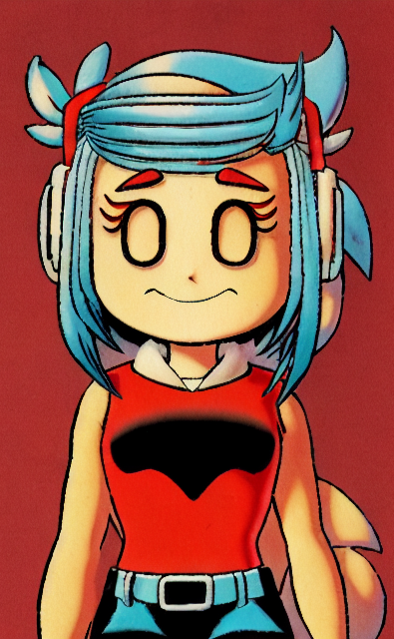
Style:
90s
Comic
Notes:
(90s comic graphic art:1.2) of <lora:A1013D_01-000002:0.7> a cartoon character, 1character, solid color background
Negative prompt: logo, dog, Watermark, bad artist, helmet, blur, blurry, text, b&w, 3d, bad art, poorly drawn, disfigured, deformed, extra limbs, ugly hands, extra fingers,, canvas frame, cartoon, 3d, ((disfigured)), ((bad art)), ((deformed)),((extra limbs)),((close up)),((b&w)), weird colors, blurry, (((duplicate))), ((morbid)), ((mutilated)), [out of frame], extra fingers, mutated hands, ((poorly drawn hands)), ((poorly drawn face)), (((mutation))), (((deformed))), ((ugly)), blurry, ((bad anatomy)), (((bad proportions))), ((extra limbs)), cloned face, (((disfigured))), out of frame, ugly, extra limbs, (bad anatomy), gross proportions, (malformed limbs), ((missing arms)), ((missing legs)), (((extra arms))), (((extra legs))), mutated hands, (fused fingers), (too many fingers), (((long neck))), Photoshop, video game, ugly, tiling, poorly drawn hands, poorly drawn feet, poorly drawn face, out of frame, mutation, mutated, extra limbs, extra legs, extra arms, disfigured, deformed, cross-eye, body out of frame, blurry, bad art, bad anatomy, 3d render
Steps: 50, Sampler: DPM++ 2M Karras, CFG scale: 7, Seed: 1938705441, Size: 640x640, Model hash: 1254103966, Model: protogenV22Anime_22

Slide 7
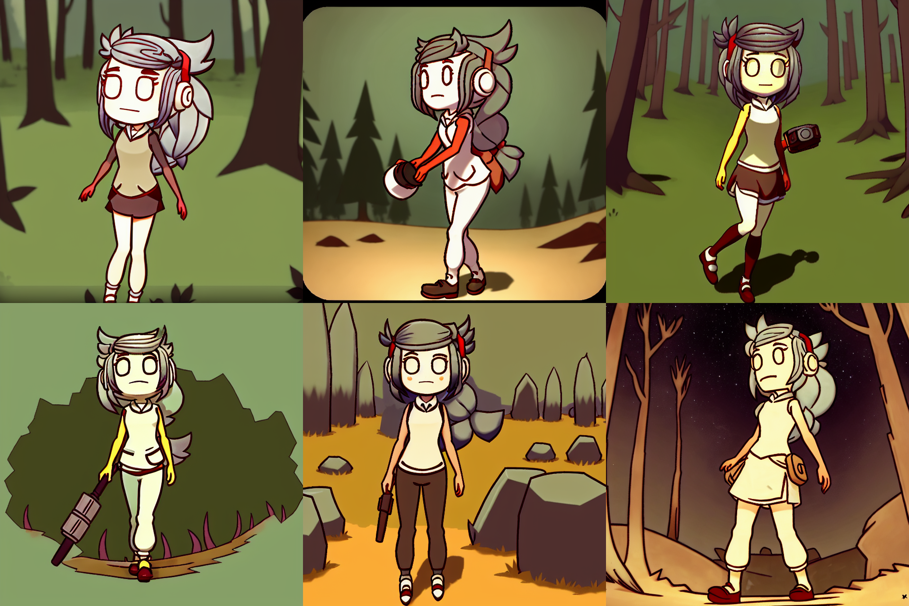
Style:
Don’t
Starve
(Video
Game)
Notes:
<lora:A1013D_01-000002:0.7> a cartoon character girl in the survival video game don't starve, full body, camera zoom out
Negative prompt: (nose:1.4), (painting by bad-artist-anime:0.9), (painting by bad-artist:0.9), watermark, text, error, blurry, jpeg artifacts, cropped, worst quality, low quality, normal quality, jpeg artifacts, signature, watermark, username, artist name, (worst quality, low quality:1.4), bad anatomy, logo, dog, Glasses, Watermark, bad artist, helmet, blur, blurry, text, b&w, 3d, bad art, poorly drawn, disfigured, deformed, extra limbs, ugly hands, extra fingers,, canvas frame, cartoon, 3d, ((disfigured)), ((bad art)), ((deformed)),((extra limbs)),((close up)),((b&w)), weird colors, blurry, (((duplicate))), ((morbid)), ((mutilated)), [out of frame], extra fingers, mutated hands, ((poorly drawn hands)), ((poorly drawn face)), (((mutation))), (((deformed))), ((ugly)), blurry, ((bad anatomy)), (((bad proportions))), ((extra limbs)), cloned face, (((disfigured))), out of frame, ugly, extra limbs, (bad anatomy), gross proportions, (malformed limbs), ((missing arms)), ((missing legs)), (((extra arms))), (((extra legs))), mutated hands, (fused fingers), (too many fingers), (((long neck))), Photoshop, video game, ugly, tiling, poorly drawn hands, poorly drawn feet, poorly drawn face, out of frame, mutation, mutated, extra limbs, extra legs, extra arms, disfigured, deformed, cross-eye, body out of frame, blurry, bad art, bad anatomy, 3d render
Steps: 50, Sampler: DPM++ 2M Karras, CFG scale: 9, Seed: 4032437672, Size: 640x640, Model hash: 1254103966, Model: protogenV22Anime_22
Time taken: 1m 2.60sTorch active/reserved: 5710/6608 MiB, Sys VRAM: 8192/8192 MiB (100.0%)

